Slide 1

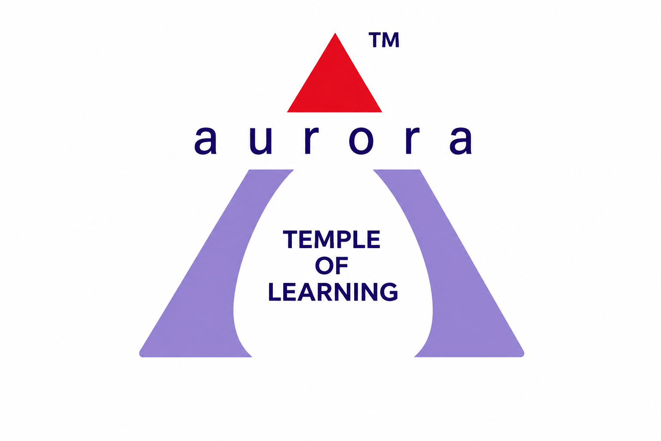
Railway Management System
Presented By
M. Khairuddin
M. Saiprasad
K. Lakshmi Prasanna
K. Sri varshitha
K. Akshay Kumar
Under the esteemed guidance of
MR. SAFWAN MOLLA
Department of Artificial Intelligence and Machine Learning Aurora Higher Education and Research Academy
(2025–26)

Slide 2
INTRODUCTION
Railway Management System is a DBMS project.
Developed to automate railway operations.
Helps manage railway records efficiently.
Reduces manual paperwork and errors.
Improves speed and accuracy of data handling.

Slide 3
NEED FOR THE PROJECT
Manual railway systems are slow and difficult to maintain.
Large amounts of passenger data must be handled daily.
Ticket reservation manually can cause mistakes.
Railway operations require fast and organized management.
Database systems improve efficiency and reliability.

Slide 4
OBJECTIVES
Develop a computerized railway database system.
Store railway information securely.
Automate reservation and cancellation processes.
Improve railway operational efficiency.
Provide faster access to railway information.

Slide 5
DATABASE OVERVIEW
The project uses multiple interconnected tables.
Stores passenger, train, ticket, and schedule details.
Maintains relationships using keys.
Supports efficient storage and retrieval of data.
Reduces redundancy in the database.

Slide 6
FEATURES OF THE SYSTEM
Ticket reservation management.
Train schedule maintenance.
Passenger record management.
Cancellation and refund handling.
Platform information management.
Fast retrieval of railway records.

Slide 7
DBMS CONCEPTS USED
Relational Database Model
Primary Keys
Foreign Keys
SQL Constraints
Normalization
Relational Schema Design

Slide 8
ER DIAGRAM
ER Diagram represents relationships between tables.
Shows connectivity between railway entities.
Helps maintain data integrity.
Simplifies database structure understanding.

Slide 9
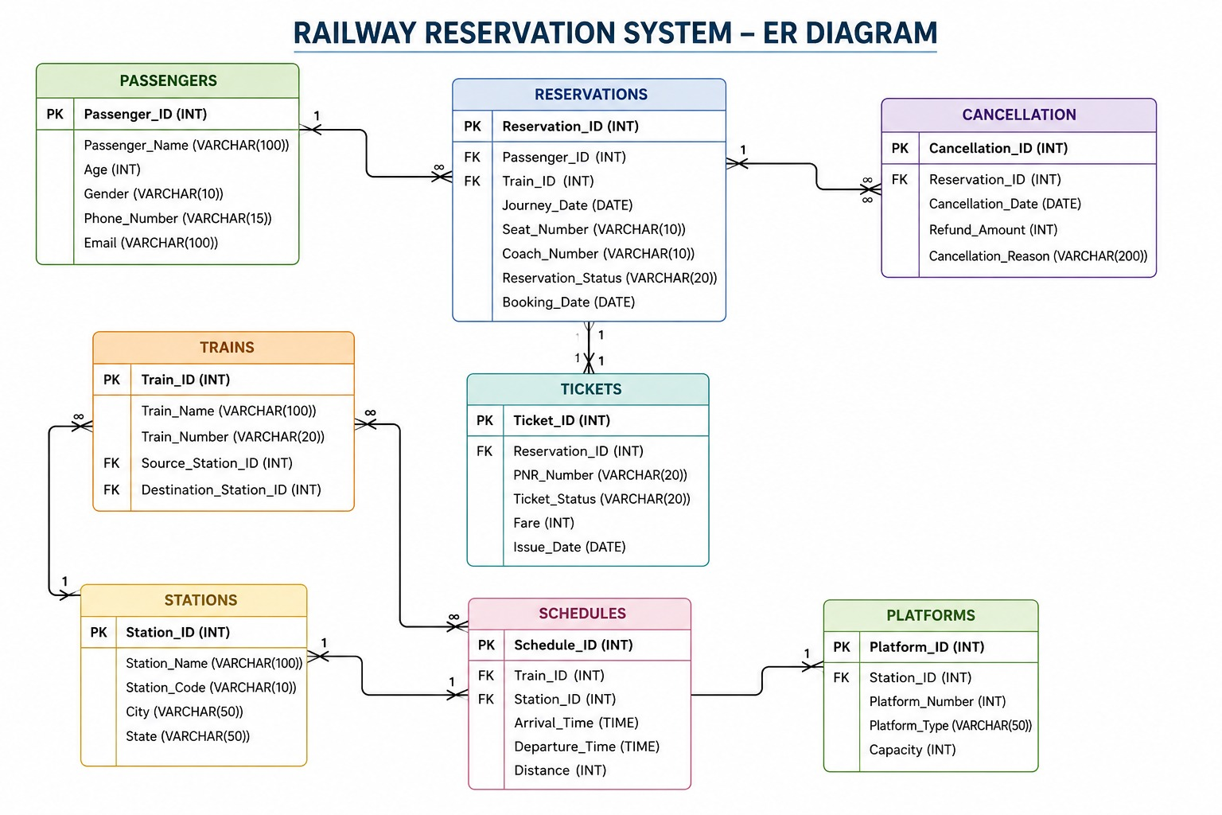

Slide 10
IMPLEMENTATION
Database created using SQL.
Tables created successfully.
Records inserted into database.
Constraints applied for consistency.
Queries executed to test the system.

Slide 11
RESULTS
Railway database executed successfully.
All records stored without errors.
Queries produced accurate results.
Database maintained proper relationships.
System performed efficiently.

Slide 12
ADVANTAGES
Reduces paperwork.
Minimizes manual errors.
Improves operational speed.
Provides organized data management.
Enhances passenger convenience.

Slide 13
APPLICATIONS
Railway reservation centers
Transportation departments
Railway stations
Metro rail systems
Smart transportation systems

Slide 14
FUTURE ENHANCEMENTS
Online ticket booking
Mobile application integration
Real-time train tracking
Cloud database support
AI-based railway automation

Slide 15
CONCLUSION
Railway Management System is an efficient DBMS project.
Automates railway operations successfully.
Provides reliable and organized data handling.
Demonstrates practical implementation of SQL and DBMS concepts.
Suitable for modern railway management applications.

